Slide 1

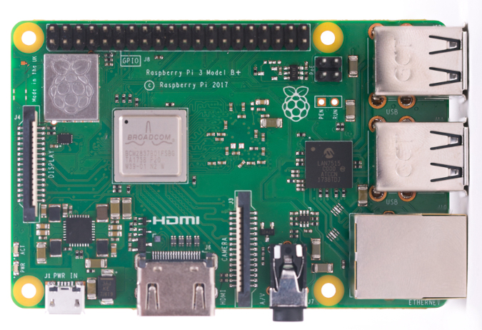

OPTIONAL: VS Code & Remote SSH
For developing on the Raspberry Pi
This Photo by Unknown Author is licensed under CC BY-SA-NC

Slide 2
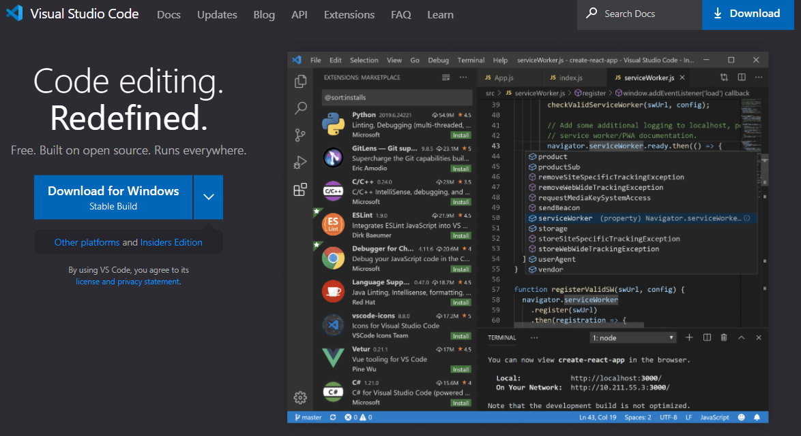
VS Code
Editor that’s Extension based

Slide 3
Visual Studio Code: Remote - SSH
The Remote - SSH extension lets you use any remote machine with a SSH server as your development environment.
This can greatly simplify development and troubleshooting in a wide variety of situations. You can:
Develop on the same operating system you deploy to or use larger, faster, or more specialized hardware than your local machine.
Quickly swap between different, remote development environments and safely make updates without worrying about impacting your local machine.
Access an existing development environment from multiple machines or locations.
Debug an application running somewhere else such as the cloud.
Official Tutorial Here: https://code.visualstudio.com/docs/remote/ssh-tutorial
INSTALL IT IF YOU WANT TO USE IT!

Slide 4
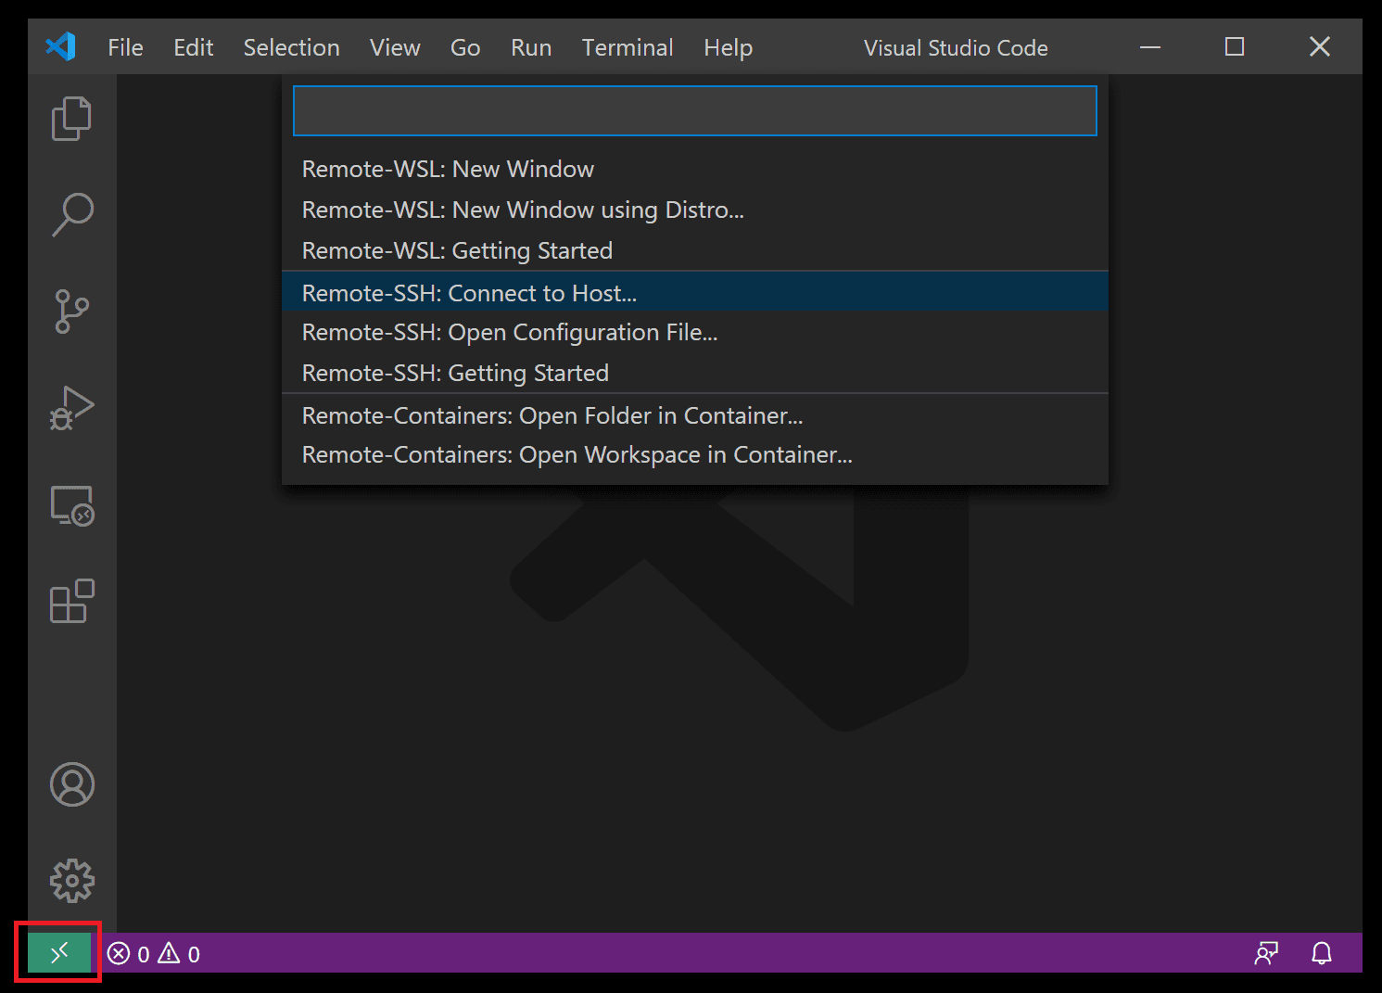
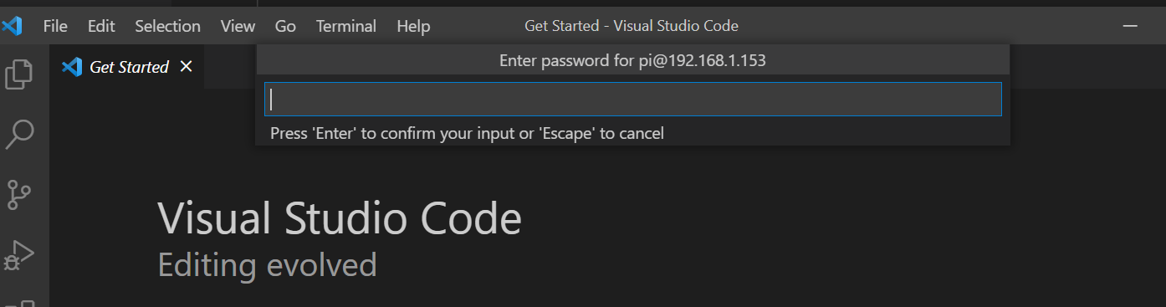
Connect using SSH
When installed, an indicator will appear on the bottom-left corner of the Status bar. This indicator tells you in which context VS Code is running (local or remote). Click on the indicator to bring up a list of Remote extension commands.
Choose the Remote-SSH: Connect to Host command and connect to the host by entering connection information for your Raspberry Pi in the following format: pi@192.168.1.234 (use your pi’s IP address.
You’ll be prompted for the password (and asked if you trust the cert)

Slide 5
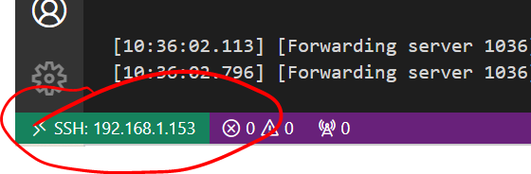
VS Code will open a new window (instance).
You'll then see a notification that the "VS Code Server" is initializing on the SSH Host. This might take a few minutes
You'll know you're connected to the Rpi by looking at the indicator in the Status bar. It’ll shows the hostname/IP address of your Rpi when connected.

Slide 6
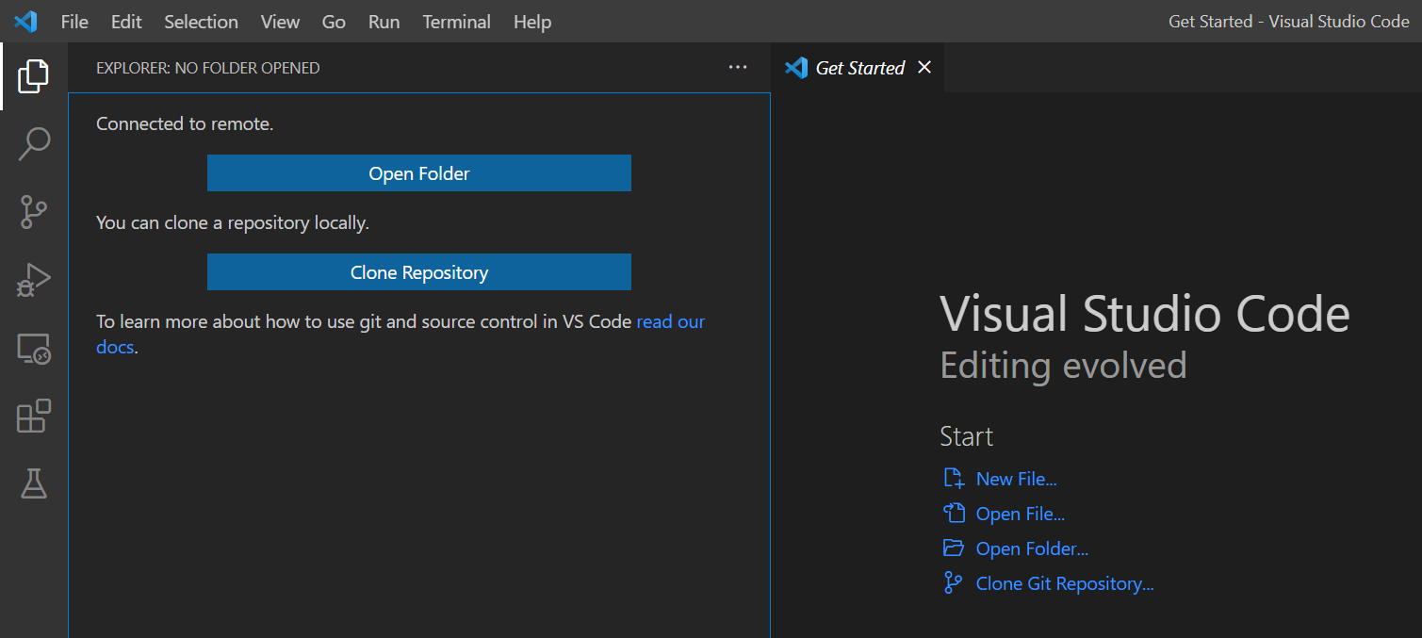
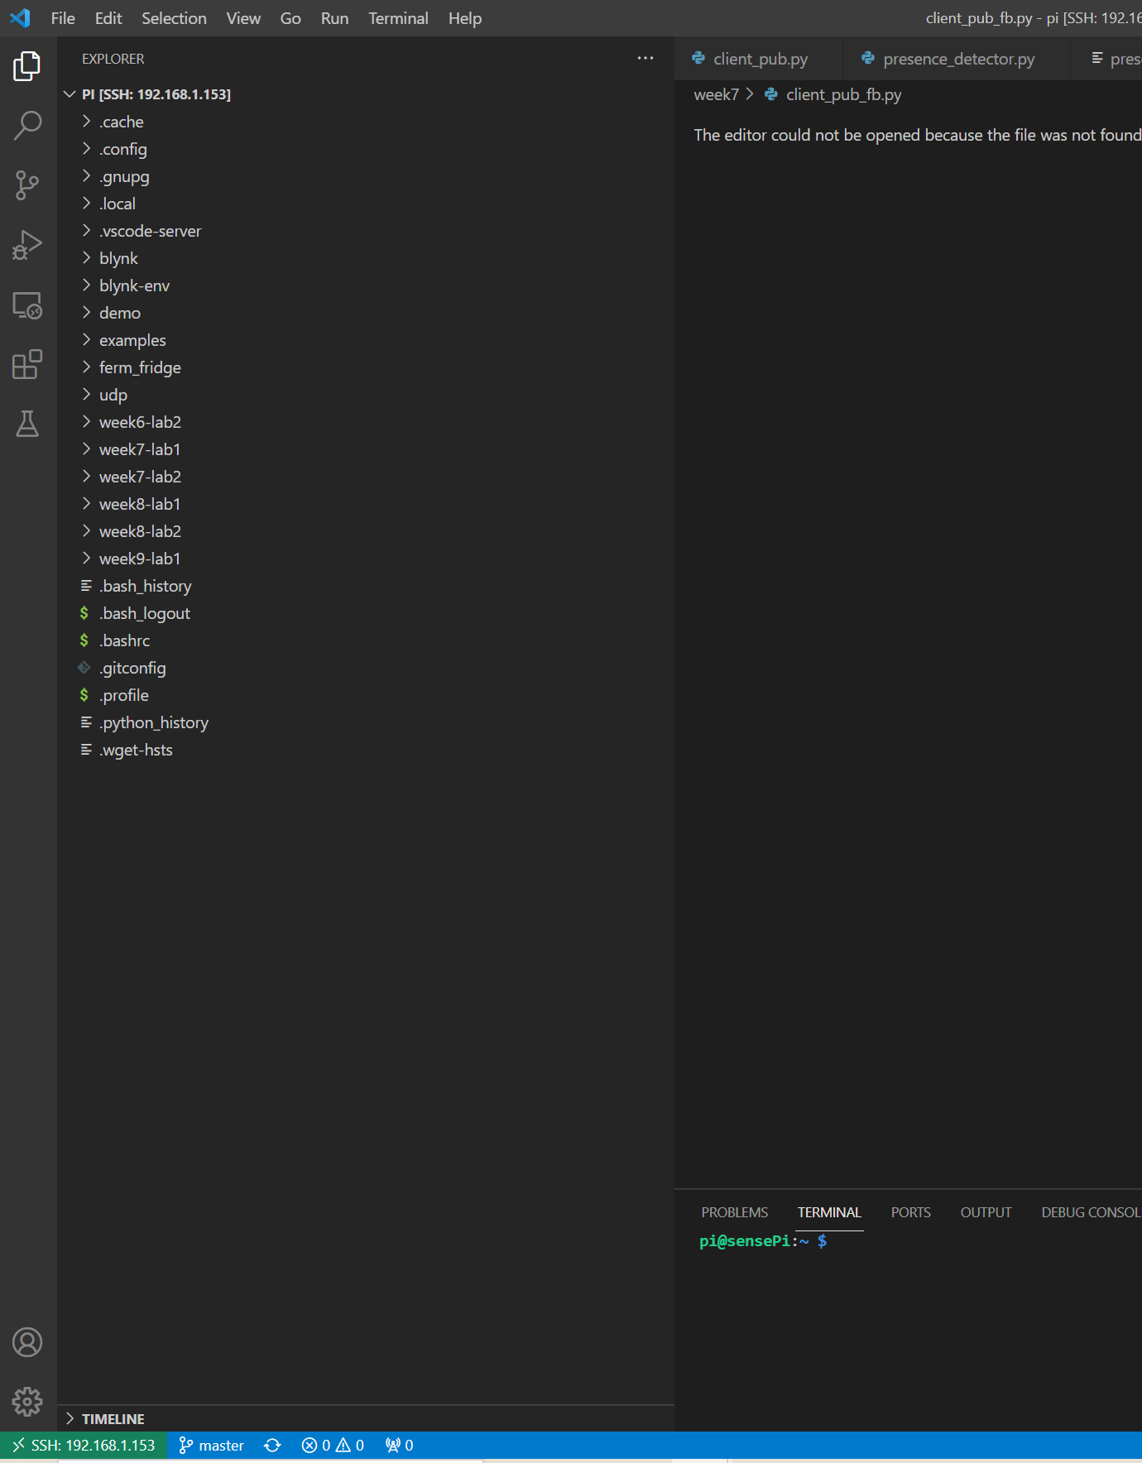



Remote File Explorer
Click on the Explorer icon and select “Open Folder” to connect the explorer to the Rpi
You should then be able to see/interact with your file system on the RPi

Slide 7
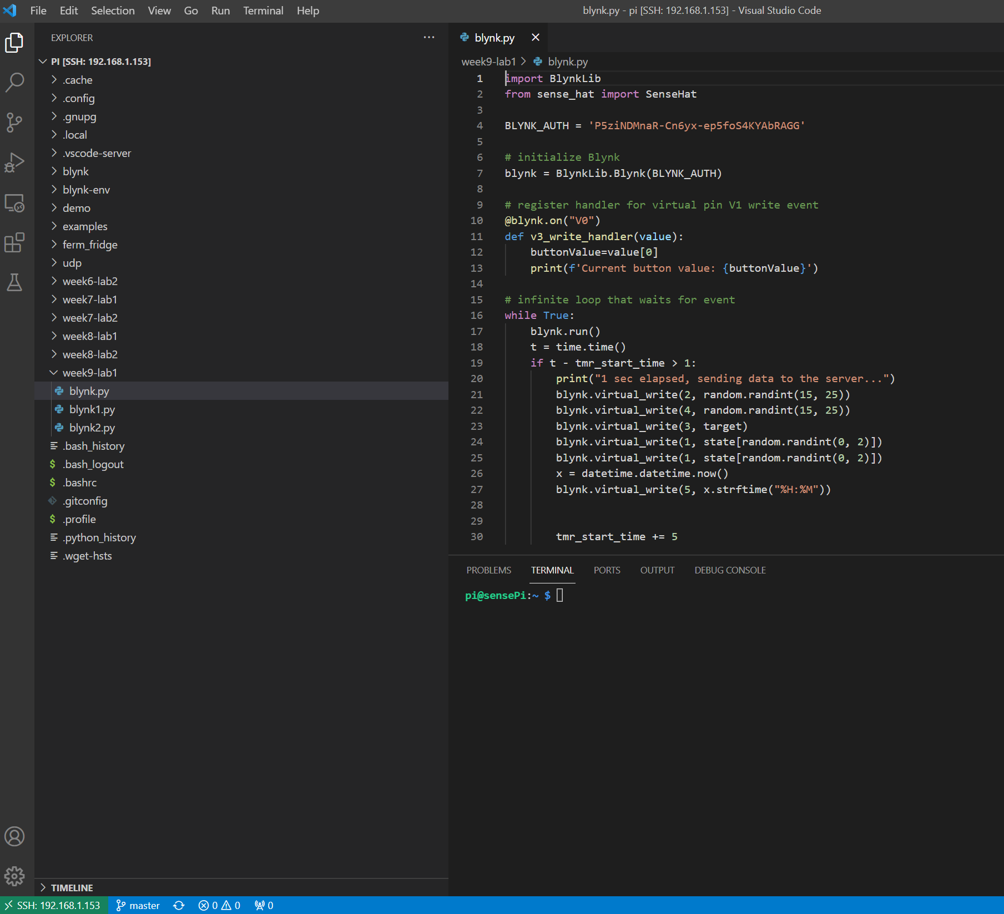
Finally!!!
File System on Rpi. Navigate folders Create/Delete files Select Files to edit
Edit Remote Files
Remote Terminal on the RPi

